Slide 1
Module 2
Adaline Madaline

Slide 2
Syllabus
Training Techniques for ANNs 10 CO2
2.1 Introduction to supervised and unsupervised learning, Adaline and Madaline
2.2 Hebbian learning, Perceptron Learning, Delta learning rule, Widrow Hoff learning, Winner take all Learning Rule , Out star learning
2.3 Multilayer Feedforward Network, Error Back Propagation Training, Learning factors.

Slide 3
Adaptive Linear Neuron (Adaline)
Adaline which stands for Adaptive Linear Neuron, is a network having a single linear unit.
It was developed by Widrow and Hoff in 1960.
Some important points about Adaline are as follows −
It uses bipolar activation function.
It tries to minimize the Mean-Squared Error (MSE) between the actual output and the desired/target output.
The weights and the bias are adjustable.

Slide 4
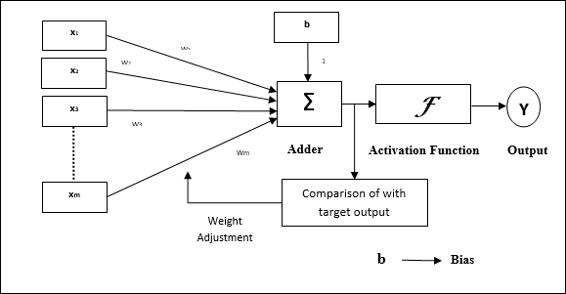
Architecture

Slide 5


Algorithm
Step 1: Initialize the following to start the training −Weights, Bias, Learning rate α
Step 2: While the stopping condition is False do steps 3 to 7.
Step 3: for each training set perform steps 4 to 6.
Step 4: Set activation of input unit xi = si for (i=1 to n).
Step 5: compute net input to output unit
Here, b is the bias and n is the total number of neurons.
Step 6: Update the weights and bias for i=1 to n
and calculate
Step 7: Test the stopping condition. The stopping condition may be when the weight changes at a low rate or no change.

Slide 6
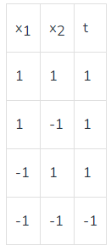
Problem:Design OR gate using Adaline Network.
Solution :
Initially, all weights are assumed to be small random values, say 0.1, and set learning rule to 0.1.
Also, set the least squared error to 2.
The weights will be updated until the total error is greater than the least squared error.

Slide 7

Calculate the net input
(when x₁=x₂=1)
Now compute, (t-y_{in})=(1-0.3)=0.7, calculate the error
Now, update the weights and bias
x₁ | x₂ | t | y_{in} | (t-y_{in}) | ∆w₁ | ∆w₂ | ∆b | w₁ (0.1) | w₂ (0.1) | b (0.1) | (t-y_{in})^2
1 | 1 | 1 | 0.3 | 0.7 | 0.07 | 0.07 | 0.07 | 0.17 | 0.17 | 0.17 | 0.49
1 | -1 | 1 | 0.17 | 0.83 | 0.083 | -0.083 | 0.083 | 0.253 | 0.087 | 0.253 | 0.69
-1 | 1 | 1 | 0.087 | 0.913 | -0.0913 | 0.0913 | 0.0913 | 0.1617 | 0.1783 | 0.3443 | 0.83
-1 | -1 | -1 | 0.0043 | -1.0043 | 0.1004 | 0.1004 | -0.1004 | 0.2621 | 0.2787 | 0.2439 | 1.01

Slide 8
Output:
Error : [2.33228319]
Error : [1.09355784]
Error : [0.73680883]
Error : [0.50913731]
Error : [0.35233593]
Error : [0.24384625]
Error : [0.16876305]
Error : [0.11679891]
Error : [0.08083514]
Error : [0.05594504]
Error : [0.0387189]
Error : [0.02679689]
Error : [0.01854581]
Error : [0.01283534]
Error : [0.00888318]
Error : [0.00614795]
Error : [0.00425492]
Error : [0.00294478]
Error : [0.00203805]
Error : [0.00141051]
Error : [0.0009762]
weight : [0.01081771 0.01081771 0.98675106] Bias : [0.01081771]
This is epoch 1 where the total error is 0.49 + 0.69 + 0.83 + 1.01 = 3.02 so more epochs will run until the total error becomes less than equal to the least squared error i.e 2.
# Predict from the evaluated weight and bias of adaline
def prediction(X,w,b):
y=[]
for i in range(X.shape[0]):
x = X[i]
y.append(sum(w*x)+b)
return y
prediction(x,w,b)
[array([1.0192042]), array([0.99756877]), array([0.99756877]),
array([-0.99756877])]

Slide 9
Madaline (Multiple Adaptive Linear Neuron) :
The Madaline(supervised Learning) model consists of many Adaline in parallel with a single output unit. The Adaline layer is present between the input layer and the Madaline layer hence Adaline layer is a hidden layer. The weights between the input layer and the hidden layer are adjusted, and the weight between the hidden layer and the output layer is fixed.
It may use the majority vote rule, the output would have an answer either true or false. Adaline and Madaline layer neurons have a bias of ‘1’ connected to them. use of multiple Adaline helps counter the problem of non-linear separability.

Slide 10
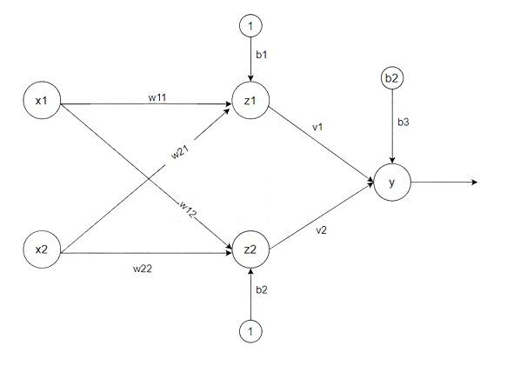
Architecture
There are three types of a layer present in Madaline
First input layer contains all the input neurons, the Second hidden layer consists of an adaline layer, and weights between the input and hidden layers are adjustable and the third layer is the output layer the weights between hidden and output layer is fixed they are not adjustable.

Slide 11
Algorithm
Step 1: Initialize weight and set learning rate α.
v₁=v₂=0.5 , b=0.5
other weight may be a small random value.
Step 2: While the stopping condition is False do steps 3 to 9.
Step 3: for each training set perform steps 4 to 8.
Step 4: Set activation of input unit xi = si for (i=1 to n).
Step 5: compute net input of Adaline unit
z_{in1} = b₁ + x₁w₁₁ + x₂w₂₁
z_{in2} = b₂ + x₁w12 + x₂w₂₂
Step 6: for output of remote Adaline unit using activation function given below:
Activation function f(z) =.
z1=f(zin1)
z2=f(zin2)

Slide 12
Algorithm
Step 7: Calculate the net input to output.
y_{in} = b₃ + z₁v₁ + z₂v₂
Apply activation to get the output of the net
y=f(y_{in})
Step 8: Find the error and do weight updation
if t ≠ y then t=1 update weight on z(j) unit whose next input is close to 0.
if t = y no updation
w_{ij}(new) =w_{ij}(old) + α(t-z_{inj})x_{i}
b_{j}(new) = b_{j}(old) + α(t-z_{inj})
if t=-1 then update weights on all unit z_{k} which have positive net input
Step 9: Test the stopping condition; weights change all number of epochs.

